Slide 1
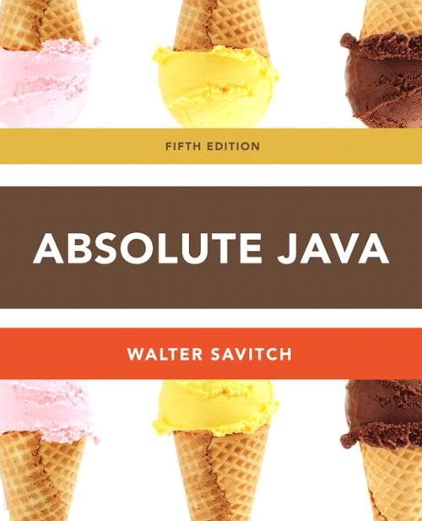
Chapter 1
Section 1.4
Program Style
Slides prepared by Rose Williams, Binghamton University
Kenrick Mock, University of Alaska Anchorage

Slide 2
Naming Constants
Instead of using "anonymous" numbers in a program, always declare them as named constants, and use their name instead
public static final int INCHES_PER_FOOT = 12;
public static final double RATE = 0.14;
This prevents a value from being changed inadvertently
It has the added advantage that when a value must be modified, it need only be changed in one place
Note the naming convention for constants: Use all uppercase letters, and designate word boundaries with an underscore character

Slide 3
Comments
A line comment begins with the symbols //, and causes the compiler to ignore the remainder of the line
This type of comment is used for the code writer or for a programmer who modifies the code
A block comment begins with the symbol pair /*, and ends with the symbol pair */
The compiler ignores anything in between
This type of comment can span several lines
This type of comment provides documentation for the users of the program

Slide 4
Program Documentation
Java comes with a program called javadoc that will automatically extract documentation from block comments in the classes you define
As long as their opening has an extra asterisk (/**)
Ultimately, a well written program is self-documenting
Its structure is made clear by the choice of identifier names and the indenting pattern
When one structure is nested inside another, the inside structure is indented one more level

Slide 5
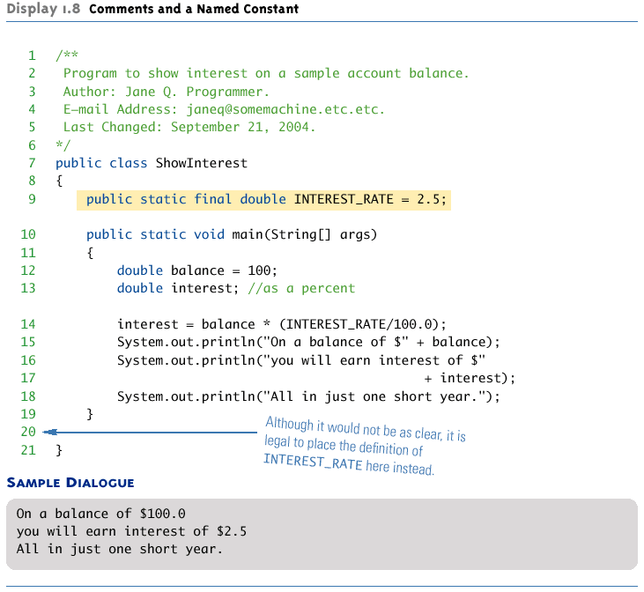
Comments and a Named Constant

